Slide 1

The Creamy Goodness of NuGet!
Jay Smith
Tyson Foods, Inc.
Notes:
I work for Tyson Foods, as a Lead Programmer Analyst for the Program Management Office. There I am one of the administrator for our Project Server 2010 implementation and Lead Developer on our project management tools we have created in house. I am also a 3 time Microsoft ASP.NET MVP.
Let’s take look at what you are here about.
How many of you have heard of NuGet?
How many of you are already using it on your projects?
If you answered no, to both or either of those we are going to fill in the missing pieces for your.
If you answered yes, then you might know some of this and if we have time we will talk about hosting your own NuGet server and why.
Let’s look at the agenda.

Slide 2
Agenda
What is NuGet?
How to add packages to your project
How to update packages in your project
How to remove packages from your project
How to create and publish your own packages
How to host your own package repository

Slide 3
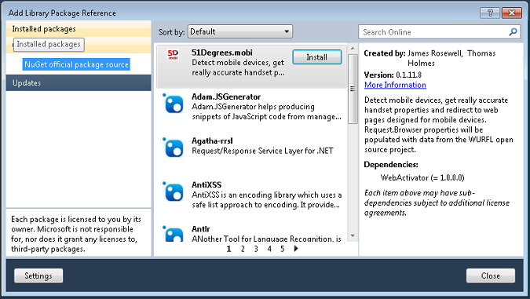
What is NuGet?
Notes:
NuGet is a Visual Studio extension that makes it easy to add, remove, and update libraries and tools in Visual Studio projects that use the .NET Framework. When you add a library or tool, NuGet copies files to your solution and automatically makes whatever changes are needed in your project, such as adding references and changing your app.config or web.config file. When you remove a library, NuGet removes files and reverses whatever changes it made in your project so that no clutter is left.
NuGet provides a quick and easy way to add features to an existing application while ensuring that those features are integrated into source control. After installing a library, you can commit changes to your source control repository, and then another developer can perform a get operation against the repository in order to start working with the new features.
Everything necessary to install a library or tool is bundled into a package (a .nupkg file). A package includes files to copy to your project and a manifest file that describes the contents of the package and what needs to be done to add or remove the library. Packages are bundled into feeds that Visual Studio accesses in order to present lists of available packages. There is an official feed that is the default source for NuGet, and you can contribute to that feed or create your own feeds.
You work with packages by using a dialog box in Visual Studio or by using PowerShell cmdlets in a dedicated Visual Studio window. Both options are accessible from the Visual Studio main menu; you can also open the dialog box from a Solution Explorer context menu. The PowerShell cmdlets require PowerShell 2.0. Therefore, NuGet requires one of the following operating systems:

Slide 4
System Requirements
The PowerShell cmdlets require PowerShell 2.0. Therefore, NuGet requires one of the following operating systems:
Windows 7
Windows Vista SP1
Windows Server 2008
Windows Server 2008 R2
Windows Server 2003 SP2
Windows XP SP3
NuGet runs in Visual Studio 2010 or Visual Web Developer 2010.
Notes:
The PowerShell cmdlets require PowerShell 2.0. Therefore, NuGet requires one of the following operating systems:
Windows 7
Windows Vista SP1
Windows Server 2008
Windows Server 2008 R2
Windows Server 2003 SP2
Windows XP SP3
NuGet runs in Visual Studio 2010 or Visual Web Developer 2010.

Slide 5
DEMO 1
Installing NuGet
Notes:
http://nuget.org/
http://visualstudiogallery.msdn.microsoft.com/ and search for NuGet

Slide 6
Adding References
Process for adding third party libraries to your solution:
Go to the site
Find the latest version
Download it to your computer
Unpack it to somewhere on our drive
Add a reference to it to your project
Make any necessary configuration file changes
Notes:
How many of you use third party libraries in your solutions?
Let’s look at what it takes to add a reference to a third party library to your solution.
What if the solution has dependencies?
Right, rinse and repeat.
Let take a look at how NuGet makes that easier on us.

Slide 7
DEMO 2
Adding/Removing/Updating
a package reference
Notes:
Open the Contoso University Solution
Show the Package Manager Console
Show the Add Package Library Reference dialog
Add a reference to Elmah
Show that the reference is added to the project
Show the web.config file changes that were made
Show where the files were stored
Show the packages.config files in the solution, remark that is content and flagged do not copy.
Build the solution and show that the Elmah.dll is in the bin directory
-- Remove elmah using the Add Library Reference Dialog
show that it removed the reference
show that it removed the config file changes
-- Let’s add it back using the package manager console
Show how to add the package via the package manager console
Get-package –remote to show the list off all packages
Get-package –remote –filter elmah
To install elmah – install-package elmah
Again lets uninstall it using the package manager console this time
Uninstall-package elmah
Ok, so we have looked at how to Add/Remove packages but what about updating?
This time lets add Nlog
get-package -remote -filter nlog
Here we want to install the older version so you can see how to update it
Install-Package NLog -version 1.0.0.505
Show the Nlog reference and that it is for version 1.0.0.505
Now let’s check to see if there are any updates
Get-Package -updates
Also show how to do this with the GUI
Update-package Nlog
You can verify that nuget installed latest version by using get-package
Again show the reference and version

Slide 8
Creating a NuGet Package
Have a library you created that you want to share with the world
Create Package Folders
Create NuGet Spec file
Add files
Use NuGet command line tool to create

Slide 9
DEMO 3
Creating a NuGet Package

Slide 10
DEMO 4
Hosting your own feed

Slide 11
Resources
NuGet Official Site: http://nuget.org
NuGet Dev Site: http://nuget.codeplex.com
NuGet Docs: http://bit.ly/bYEwEx
NuGet Package Explorer: http://bit.ly/fYIHHi
NuGet Copy Script: http://bit.ly/gTJhPi
My Blog: http://jaysmith.us
Twitter: @JaySmith
Email: Jay@jaysmith.us

